Slide 1
Stress Management in the Workplace: Navigating a Pandemic
Ana’ Bell, MS
Ana.b.1@bwc.state.oh.us

Slide 2
Welcome
Ana’ Bell, M.S.
PhD Candidate – The Ohio State University Kinesiology, Department of Human Sciences
Dr. Sears Certified Health and Wellness Coach
Intern – Better You, Better Ohio! Ohio Bureau of Workers’ Compensation
Graduate Administrative Associate – The Ohio State University, Office of Diversity, Outreach & Inclusion, College of Engineering

Slide 3
Recognizing where we are

Slide 4
Pandemic life
Work and careers
Family and social circles
Education and the ways we learn

Slide 5
Altered experiences
Moving and interacting asynchronously
Difficult to establish routines
Challenging to connect with others

Slide 6
The Results
We are disoriented and deteriorating.

Slide 7
Exploring Change

Slide 8
Change…
Change impacts every area of our lives
Change isn’t good or bad
Change is not linear
Too much change can be stressful
Sad
Lonely
Anxious
Confused
Guilty

Slide 9
Let’s talk about Stress

Slide 10
What is stress
Emotional, physical, mental tension
A normal feeling
Our bodies reactions to:
challenges & demands
Two types of stress
Acute
Chronic

Slide 11
Acute Stress
Short term stress
Least damaging
Can be positive
Most Common
Notes:
Examples
Amazon package being delayed
Video being streamed isn’t loading
Wanted to do some yard work in prep for spring but a rainstorm suddenly rolls in.

Slide 12
Acute stress in the workplace
Most common type of stress
Short term
In the Workplace
A “busy season”
Annual company conference or workshop series
Upcoming deadline for a quarterly report

Slide 13
Chronic Stress
Long term stress
Emotional and mental pressure
May produce feelings of little to no control
Associated with traumatic events

Slide 14
Chronic stress in the workplace
Working during a pandemic
Ongoing threats to job security
Conflict with others
Toxic culture or work environment
Little to no growth or advancement opportunities

Slide 15
Chronic Stress and the body
Chemicals in the body are released
Corticosteroids
Norepinephrine/epinephrine
Build up over time
Flight or fight all the time
Freeze

Slide 16
Chronic Stress and the body
Impacts of Chronic Stress
High blood pressure (stroke)
Damage to muscle (heart attack)
Suppress the immune system
Anxiety, depression
Headaches
Sleep problems
Concentration problems
Weight gain
Change in bowel habits
Trouble sleeping/sleeping too much
Forgetfulness

Slide 17
Where is your stress at?

Slide 18
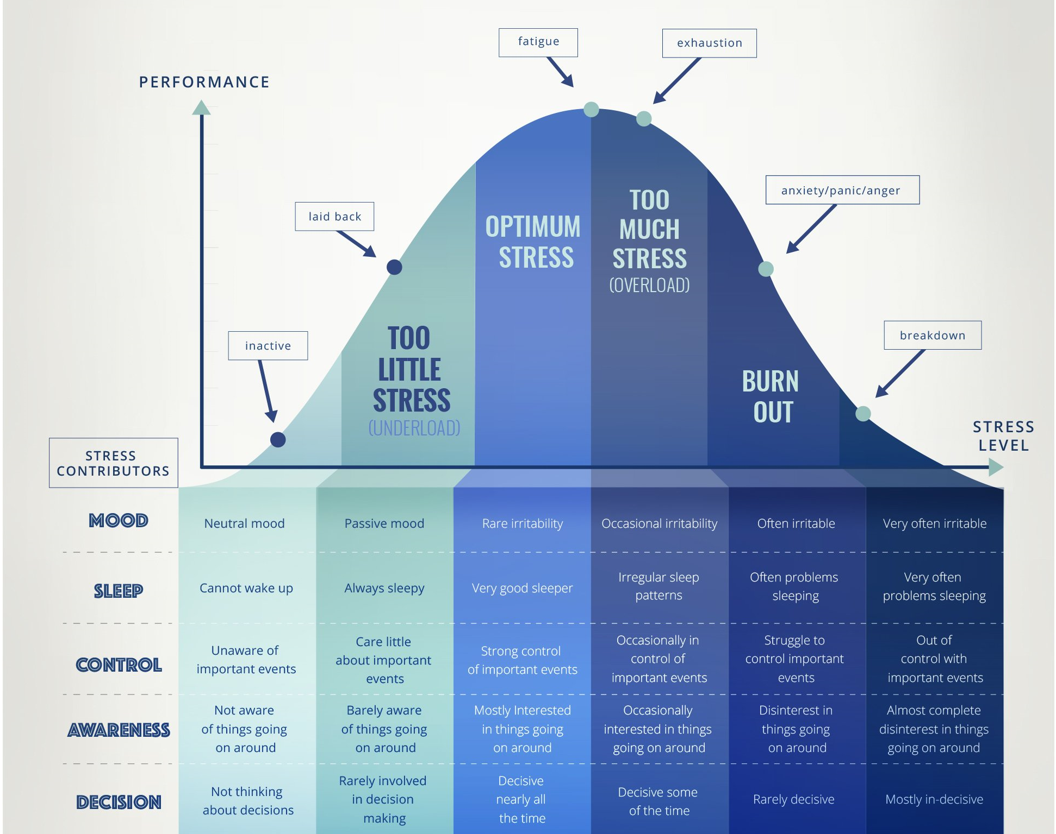
Stress curve
Notes:
Image Credit: https://www.thechelseapsychologyclinic.com/wp-content/uploads/2018/04/CPC_CHART_V21.jpg

Slide 19
Outside of optimal stress
We may feel:
Sadness
Guilt
Loneliness
Isolation
Fear
Anger

Slide 20
Reframing change

Slide 21
Change is going to come
Acknowledge your feelings
Assess the situation
Reframe your views on change

Slide 22
Reframing change
Frame change outside of your emotions
Talk about your emotions
Develop practical ways to cope

Slide 23
Reframing change
See change as an opportunity for growth
- Can I learn a new skill?
- What skills or resources do I have that I can use?
- How can I grow?

Slide 24
Managing change in the workplace
Speak up during meetings, forums, townhalls
Use suggestion boxes and “office hours”
Schedule meetings with work groups or leadership
Rely on co-workers
Tap into company resources

Slide 25
Stress Management

Slide 26
Taking inventory of stress
Be observant, know your stressors
Gather support and resources
Talk to your provider

Slide 27
Care for your Physical Health
Regular exercise
30 minutes a day
Relaxing activities
Breathing exercises
Self-care
Eat healthy
5 fruits and veggies a day
More food cooked at home
Sleep well
Develop a sleep routine

Slide 28
Managing work related stress
Set goals
Prioritize
Say no
Determine work related needs
Change in responsibility
Change in employment
Have candid conversation
With peers and leadership

Slide 29
Managing work related stress
Identify beneficial resources
Work group or project team
Change your physical space
Photos, stress ball, sweater
Give yourself and others grace
Additional time may be needed for “normal” activities

Slide 30
Reducing stress while teleworking
Have a morning routine
Try to have a schedule for you and children
Engage when you can by video
Schedule breaks
Get outside or at least leave your office space
Have a designated workspace
Have firm starting and stopping times

Slide 31
Practice Mindfulness and self-care
Mindfulness is
Quality of being aware
Focus awareness
Accept feelings
Self-Care
Activities and habits that support your whole being

Slide 32
Resources – stress Management
Click here for the Adult Resource page that the state has prepared.
There is information about mental health services, recovery and addiction support, health and fitness information, and resources for financial concerns as well.
Click here to be taken to the CDC website about managing stress and anxiety during the pandemic.
It offers information to help with children that may be experiencing stress as well.
Click here to be taken to the CDC website about dealing with a traumatic event.
It also offers resources for others in your family.
Click here to see SAMHSA and their information about mental wellbeing during an infectious disease outbreak.
Click here to watch a video that discusses stress and management.
They also have provided information here about dealing with a traumatic event.

Slide 33
Resources – health and Wellbeing
Click here for information about sleep
Click here for information about nutrition
Click here for information about physical activity
Click here for more information about Mindfulness

